Slide 1
Brent Centre Highlands
2023

Slide 2
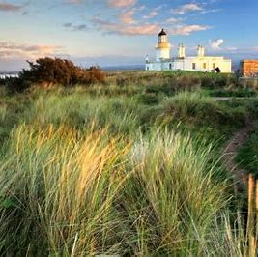
Who are we?
A charity, founded in the 1960s, our approach has informed adolescent services and how they work
Internationally renowned for developing psychotherapeutic work with young people
Our Centre offers psychotherapeutic services and develops research on adolescence
A community organisation in NW London providing help and support to around 800 young people in a year
Since January 2023, a cross border charity, operating in Scotland, with a new project – Brent Centre Highlands

Slide 3
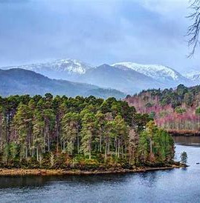
How do we work?
Our clinical model is informed by psychoanalytic practice, and developmentally sensitive, creating a unique space for adolescents and young people that is different to a child and adult service
Typically we offer young people:
Adolescent Exploratory Therapy – a series of flexible consultations
Psychotherapy
Family and Parent consultation where appropriate
Group work
Practical support
Consultation and thinking space for professionals
Specific projects tailored/developed according to community needs e.g Sport and Thought, working with Irish Travellers, Looked after children, Young offenders
o

Slide 4
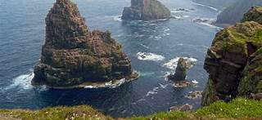
What are we hoping to do in the Highlands?
An administrative base and consulting room at 8a Stephens Brae, Inverness – our operational headquarters!
Idea of ‘hubs’ of service across the Highlands, starting with Inverness and Caithness
3 year pilot – currently in year 1, having registered with OSCR in January 2023, we hope we can build a substantial psychotherapeutic resource for young people in the Highlands over time
We’ve raised about 35% of the funding we need to operate, and we’re getting closer to opening the doors to young people

Slide 5
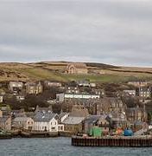
Psychotherapy resource free at the point of access
For young people aged between 14 – 21 years
Young people might be experiencing a range of difficulties such as; low mood, anxiety, self harm, suicidality, trauma, abuse, bereavement, or have concerns about relationships, study / school, employment, sexuality, their body,
Young people can self refer or be referred by a GP or other health professional

Slide 6
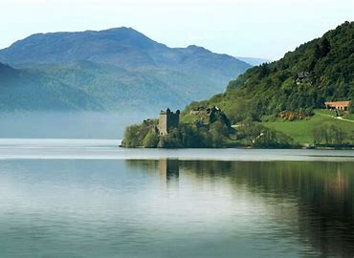
Key Challenges
Fundraising!
Recruitment
Avoiding an overwhelm of referrals when we open
High need – using our resources as effectively as we can to help whilst starting out

Slide 7
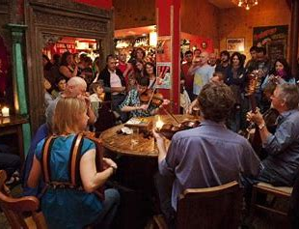
How can you help?
Keep in touch with any ideas, contacts or funding possibilities:
Sarah Fielding
Mobile 07969060541
Email: highlands@brentcentre.org.uk
Follow us on Twitter: @Brenthighlands
Tell you friends / networks we’ll be recruiting!

